Slide 1
Fantastic 5
“Refreshingly innovative…”
Christopher Mahon: Team Leader
Christopher Jerrard-Dunne: Coder/Designer
Konrad Jedrol: Planner
Jun Hee Jang: Tester
Jake Mulholland: Documenter

Slide 2
Overview
Agile VS Waterfall
Both considered for our project
Closely related to software development
Distinct

Slide 3
The Waterfall Methodology
Moves through various steps as time progresses
Cannot revisit previous steps
Plan must be followed carefully

Slide 4
Why/Why Not?

Slide 5
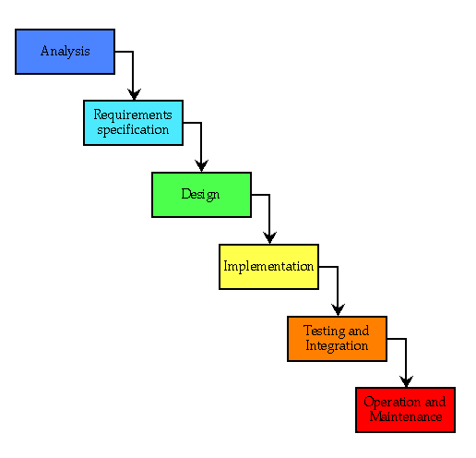
Diagram

Slide 6
The Agile Methodology
Developed as a response to waterfall
Works with small modules in sprints
Criticized for its collaborative approach

Slide 7
Why/Why Not?

Slide 8
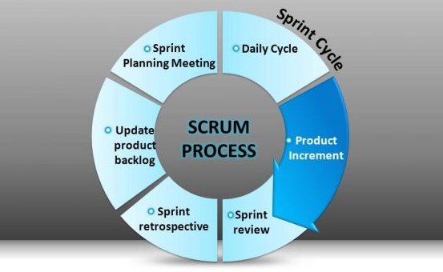
Diagram

Slide 9
Conclusion
No ‘One size fits all’ approach
Both suit separate environments
Do not need to conform to one approach

Slide 10
Questions?

